Slide 1
Signal Processing on Databases
Jeremy Kepner
Lecture 6: Bio Sequence Cross Correlation
This work is sponsored by the Department of the Air Force under Air Force Contract #FA8721-05-C-0002. Opinions, interpretations, recommendations and conclusions are those of the authors and are not necessarily endorsed by the United States Government.
Notes:
Title slide.

Slide 2
Outline
Introduction
Algorithm
Implementation
Results
Summary
Notes:
Outline slide.

Slide 3
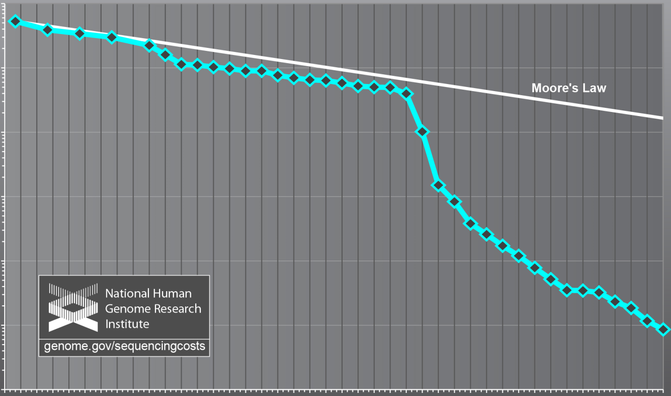
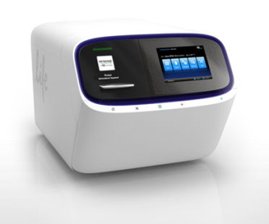
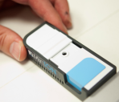
Relative Cost per DNA Sequence
Big Data
Energy Efficient
Portable
Sequencer
High Volume Sequencer
Wetterstrand KA. DNA Sequencing Costs: Data from the NHGRI Large-Scale Genome Sequencing Program Available at: www.genome.gov/sequencingcosts. Accessed 03/08/2012
Notes:
DNA sequencing is now a “Big Data” problem. The cost per base pair continues to decrease and the data volume continues to increase dramatically. The next wave of innovations include nanopore technologies that will likely increase DNA read lengths and instrument miniaturization to the size of a USB stick.

Slide 4
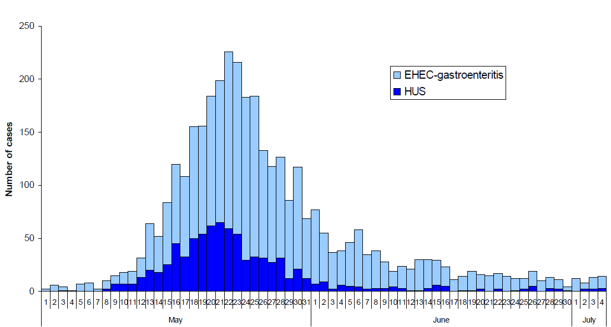
Example Disease Outbreak
May-July 2011 - Virulent E. Coli Outbreak Germany
Outbreak
identified
Spanish
Cucumbers
implicated
diarrhea
kidney
DNA
Sequence
released
Sprouts
Identified
Deaths
www.rki.de EHEC final report
Conclusions: Identification of E. Coli source too late to have substantial impact on illnesses
Publishing sequence data allowed for broad community to fully characterize pathogen
Sequencing and crowd source analysis showed promising potential -> Still too slow
Notes:
Last year, 43 people died and more than 3,000 were infected with a virulent strain of E. coli. A PCR assay was developed within a week, but it still took 20 days to correctly identify the source of the infection as the sprouts. With any outbreak, rapid identification and characterization is important for saving people’s lives.

Slide 5
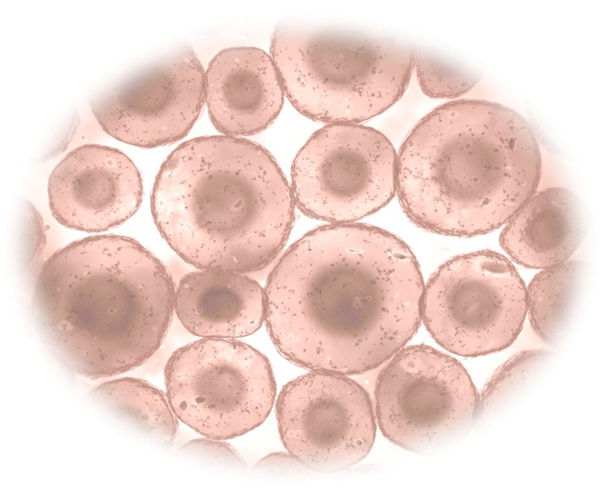

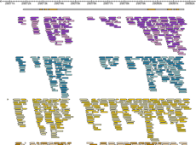
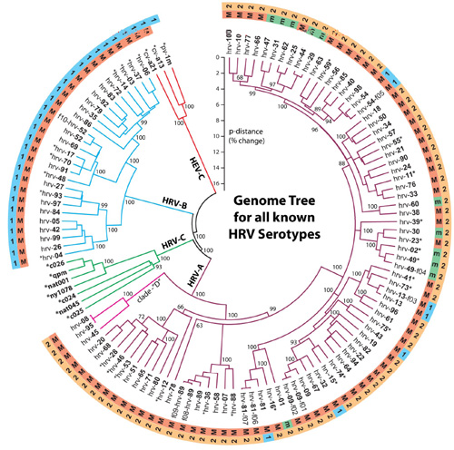
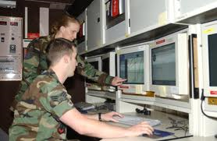
Example Processing Timeline
Collection &
Shipment of
Sample
Sample
Preparation &
Sequencing
Time to
Actionable
Data
Analysis of
Samples
Complex
Background
Natural
Disease
Human Infection
Bio-Weapon
Release
Current | 2-30 days | 1-3 days | 7-14 days | 10-45 days
Goal | on site | 3 hours | <12 hours | < 1 day
Processing plays a key part in accelerating the overall time to solution
Slide inspired by Nicole Rosenzweig, ECBC
Notes:
Sequence data analysis is the current bottleneck to actionable data. In the near future, it should be possible to deploy next generation sequencers coupled with a computational system for the rapid characterization of pathogens.
5

Slide 6

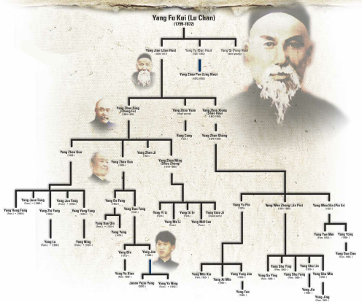
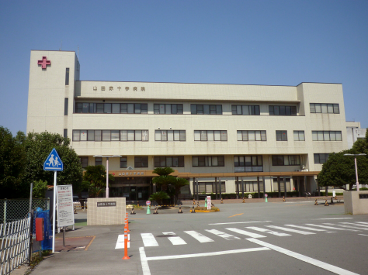
DNA Sequence Matching
Goal
Quickly compare two sets of DNA
Applications
Identification
Mixture Analysis
Kinship Analysis
Ancestry Analysis
Uses: disease outbreaks, criminal investigations, personal medicine, …
Challenge: sequencing matching takes a long time, can we make it faster?
Notes:
DNA sequence matching has a wide variety of applications.

Slide 7
Outline
Introduction
Algorithm
Implementation
Results
Summary
Notes:
Outline slide.

Slide 8
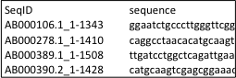
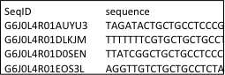
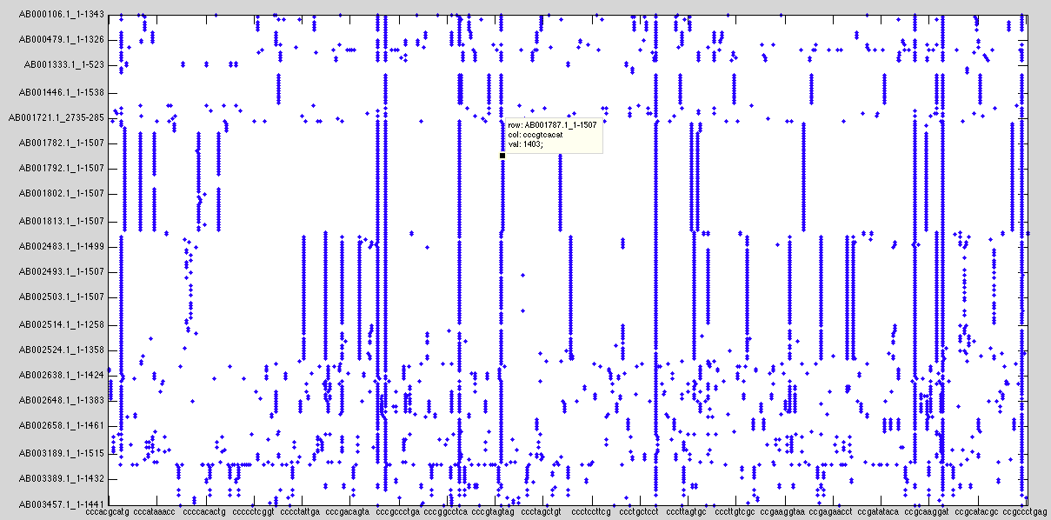
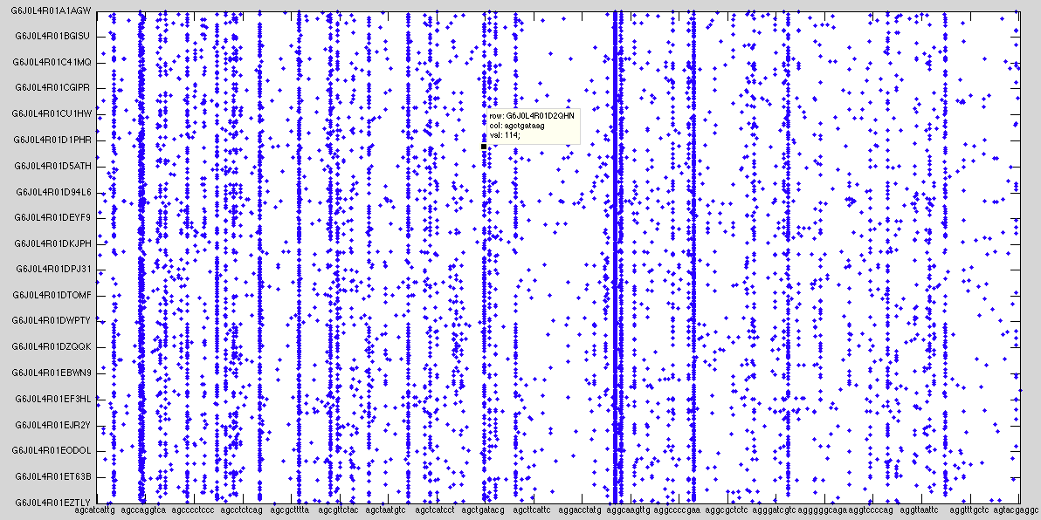
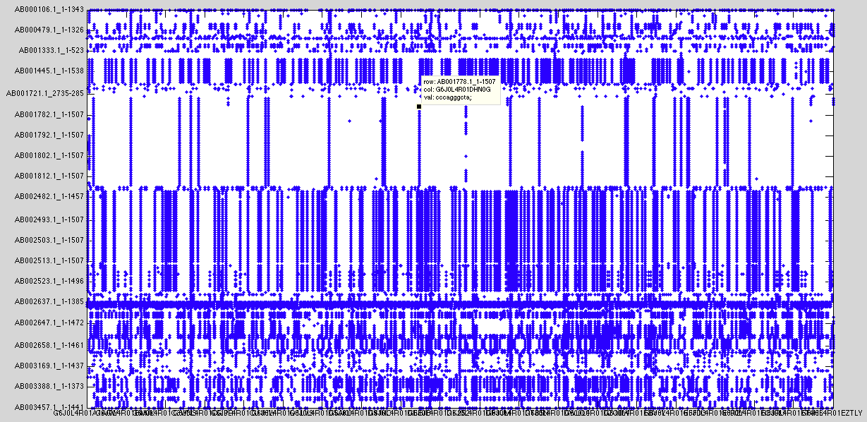
Sequence Matching ⬄ Sparse Matrix Multiply in D4M
RNA Reference Set
Collected Sample
reference
bacteria
unknown
bacteria
A₁
A₂
reference
sequence ID
unknown
sequence ID
A₁ A₂'
sequence word (10mer)
sequence word (10mer)
reference
sequence ID
unknown sequence ID
Associative arrays provide a natural framework for sequence matching
Notes:
Finding common base sequences can be performed with a single matrix multiply in D4M.

Slide 9
Database Automatically Computes Reference 10mer Distribution
0.5%
5%
50%
Using 10mer distribution can quickly select reference 10mers that maximally differentiate sample sequences and eliminate most 10mers
Notes:
Database allow most important 10mers to be selected quickly.

Slide 10
0.5% Selection Results
Sample (20MB):
NGS from Roche 454
Reference (500MB):
Virus DNA from GenBank
All strong matches detected using 0.5% of data
measured 10mer matches
Signal
Noise
true 10mer matches
Notes:
Using 0.5% of the data nearly all the strong matches can be detected.

Slide 11
Cumulative Probability of Detection
cumulative
probability of detection
true 10mer matches
100% detection of all true matches > 100
Notes:
All true matches >100 are found.

Slide 12
Cumulative Probability of False Alarm
cumulative
probability of false alarm
measured10mer matches
Measured matches > 10 are always matches
Notes:
Low false alarm rate.

Slide 13
Finding Matches
reference
SeqID
A = A1 * A2'
Ak = CatKeyMul(A1,A2')
unknown SeqID
Find sequences with >6 word matches
Am = Ak(Row(A > 6),Col(A > 6))
(AB001520.1_1-1428,G6J0L4R01B4UPM) aaatctttaa;aatctttaaa;ctttaaataa;ggggaccagc;taaatcttta;ttaaataaaa;tttaaataaa;,
(AB002634.1_1-1419,G6J0L4R01EDJVA) aaatgtcgtt;aatgtcgttt;atgtcgtttc;gtcgtttccc;gtctcagttc;tcgtttccct;tgtcgtttcc;,
Associative array cat multiply preserves pedigree of matches
Notes:
Other matrix multiplies can be defined which allow the pedigree of the correlations to be preserved.

Slide 14
Sequence Alignment
Show relative alignments of sequences
A1(Row(Am),Val(Am)) + A2(Row(Am),Val(Am))
reference sample
AB001520.1_1-1428 G6J0L4R01B4UPM
aaatctttaa 564 155
aatctttaaa 1227 156
ctttaaataa 1376 159
ggggaccagc 877 58
taaatcttta 563 154
ttaaataaaa 1378 161
tttaaataaa 1377 160
AB002634.1_1-1419 G6J0L4R01EDJVA
aaatgtcgtt 933 300
aatgtcgttt 934 301
atgtcgtttc 935 302
gtcgtttccc 937 304
gtctcagttc 1211 37
tcgtttccct 938 305
tgtcgtttcc 936 303
taaatctttaa … ggggaccagc … ctttaaataaaa
ggggaccagc … taaatctttaaataaaa
aaatgtcgtttccct … gtctcagttc
gtctcagttc … aaatgtcgtttccct
Sequence alignment found by indexing into associative array
Notes:
Lookup achieved by indexing into array.

Slide 15
Outline
Introduction
Algorithm
Implementation
Results
Summary
Notes:
Outline slide.

Slide 16

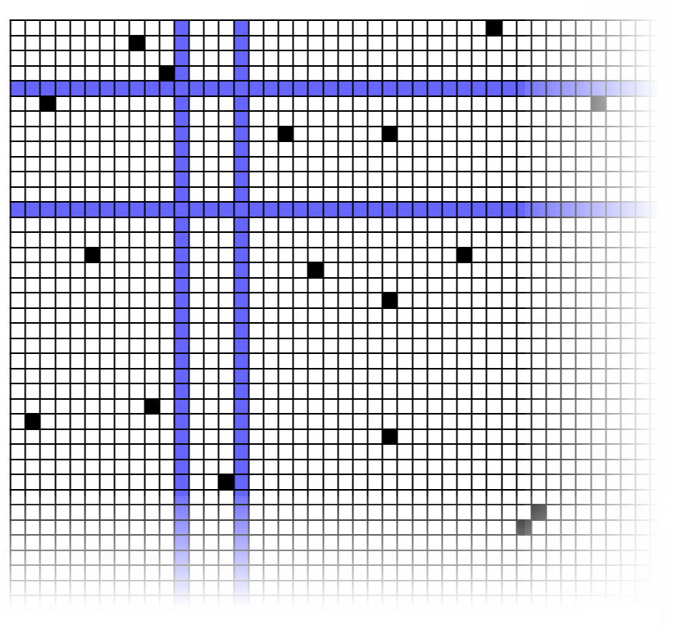
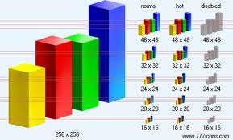
D4M Stores Giant Sparse Matrices in Accumulo Triple Store Database
Triple Store
Distributed Database
D4M
Dynamic
Distributed
Dimensional
Data
Model
Associative Arrays
Numerical Computing Environment
A
B
C
Query:
T(:,ggaatctgcc)
E
D
A D4M query returns a sparse matrix or graph from a triple store…
Triple store are high performance distributed databases for heterogeneous data
…for statistical signal processing or graph analysis in Matlab
Notes:
D4M (Dynamic Distributed Dimensional Data Model) provides a uniform way to view and manipulate complex data.

Slide 17
Sequence Processing Pipeline
Row
Seq. ID
Reference
Accumulo DB
Seq. Data
Fasta
C Parser
Col
Seq.
Matlab
to Assoc
Matlab D4M Comparison
Top
Matches
Val
Position
.mat
Sample
Matlab Header Parser
Accumulo DB
Header Data
Matlab Match Linker
C-Parser
Generate n-mer words from
Fasta DNA data in D4M format
Preprocess & filter the sequences
Ignore bad, common sequences
Break output files into manageable chunks, say 5MB
Generate reverse sequences
Break up big sequences into subsequences to preserve locality
Top Taxonomic Matches
Notes:
Sequence matching requires a complete data pipeline. Parsing data into triples is best done with a compile language.

Slide 18
Database Table Splits
Initial inserts bottleneck on one tablet server until it fills up and splits
Performance booster: pre-split table among several tablet servers for instant parallel insertion
Use advanced knowledge of row data patterns to choose splits
Created functions to set and query table splits
No Splitting
Table Splits
Inserter
Inserter
Tablet Server
Tablet Server
Inserter
Inserter
Inserter
Inserter
Tablet Server
Tablet Server
Inserter
Inserter
Notes:
Pre-splitting database tables is essential for parallel performance.

Slide 19
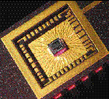
Accumulator Columns
Accumulator columns allow counting to be done on insert
Example: sequence counting
Row ID = 10 mer
Column = Count
Value = Count
Insert (aaatctttaa,Count,2) → DB has (Doc1, ‘bird’, 2)
Insert (aaatctttaa,Count,3) → DB has (aaatctttaa,Count,5)
Works with any commutative operation
Addition, maximum, minimum, etc.
Database Accumulator
Inserter
 | Col
Row | SUM
Inserter
Inserter
Notes:
Accumulator columns allow counting to be done on insert.

Slide 20
Outline
Introduction
Algorithm
Implementation
Results
Summary
Notes:
Outline slide.

Slide 21
Table Split Performance
Pre-Splitting tables appropriately can double ingest rates at higher Np in multinode database environments
Notes:
Exclusive mode ensures maximum usage of network and minimizes other jobs’ impact on runs

Slide 22
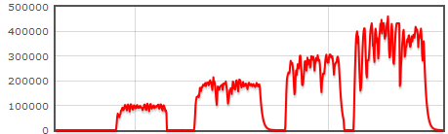
Human DNA DB Ingest Performance
Accumulo Instance8 Tablet Server (2 cores each)
Np = 2
Np = 4
Np = 8
Np = 16
4.5 GB human Fasta file
C Parser took 25 minutes
101 GB of row, col files
Database ingest time ~10 hours
Notes:
Benchmark performance on actual human DNA.

Slide 23
Leveraging “Big Data” Technologies for High Speed Sequence Matching
D4M
100x smaller
BLAST
100x faster
D4M +
Triple Store
High performance triple store database trades computations for lookups
Used Apache Accumulo database to accelerate comparison by 100x
Used Lincoln D4M software to reduce code size by 100x

Slide 24
Summary
Big data is found across a wide range of areas
Document analysis
Computer network analysis
DNA Sequencing
Currently there is a gap in big data analysis tools for algorithm developers
D4M fills this gap by providing algorithm developers composable associative arrays that admit linear algebraic manipulation
Notes:
Summary

Slide 25
Example Code & Assignment
Example Code
d4m_api/examples/2Apps/4BioBlast
Assignment
None
Notes:
Example Code and Homework assignment.

